Slide 1



BRITISH AIRWAYS
SENTIMENT ANALYSIS OF BRITISH AIRWAYS REVIEWS
HAFIZ MUHAMMAD SHAHRYAR

Slide 2
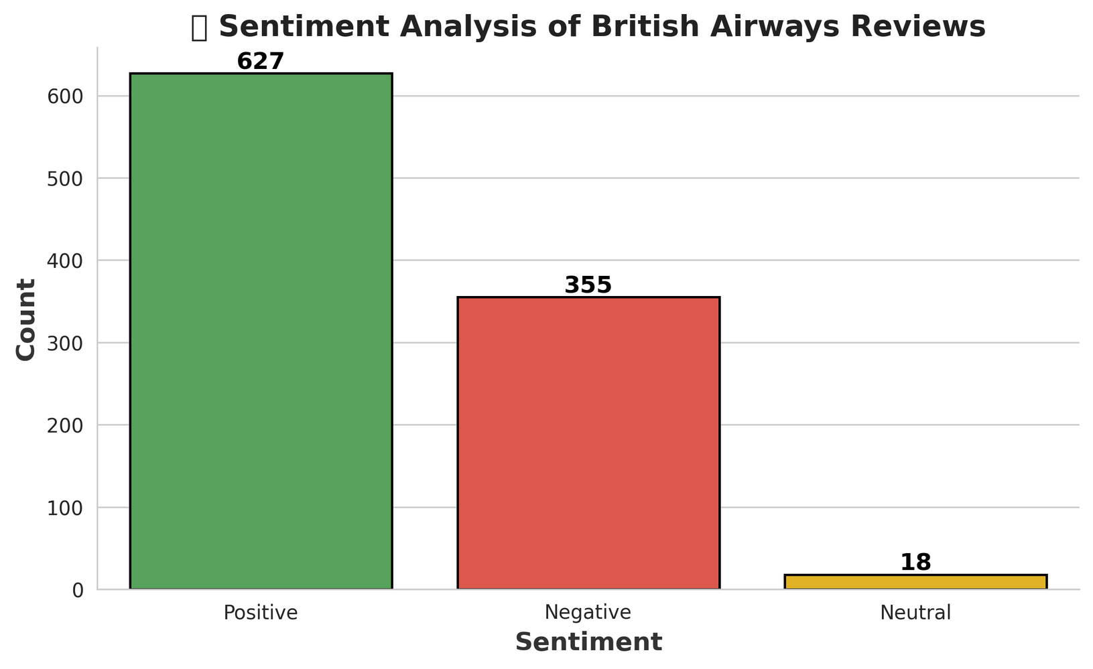
TOTAL REVIEWS
1000
1
627 POSITIVE
2
355 NEGATIVE
3
627 POSITIVE
HAFIZ MUHAMMAD SHAHRYAR

Slide 3




1️⃣ MAJORITY POSITIVE:
627 reviews (62.7%) are positive, indicating overall customer sATISFACTION
2️⃣ SIGNIFICANT NEGATIVE FEEDBACK:
355 reviews (35.5%) are negative, suggesting areas of improvement.
3️⃣ MINIMAL NEUTRAL SENTIMENT:
ONLY 18 reviews (1.8%) are neutral, showing that most customers have strong opinions.
4️⃣ POTENTIAL PAIN POINTS:
COMMON negative topics may include delays, baggage issues, and customer service complaints (if analyzed further).
5️⃣ BUSINESS IMPLICATION:
WHILE THE MAJORITY OF REVIEWS ARE POSITIVE, ADDRESSING negative feedback areas can further enhance customer experience and brand reputation.
HAFIZ MUHAMMAD SHAHRYAR

Slide 4

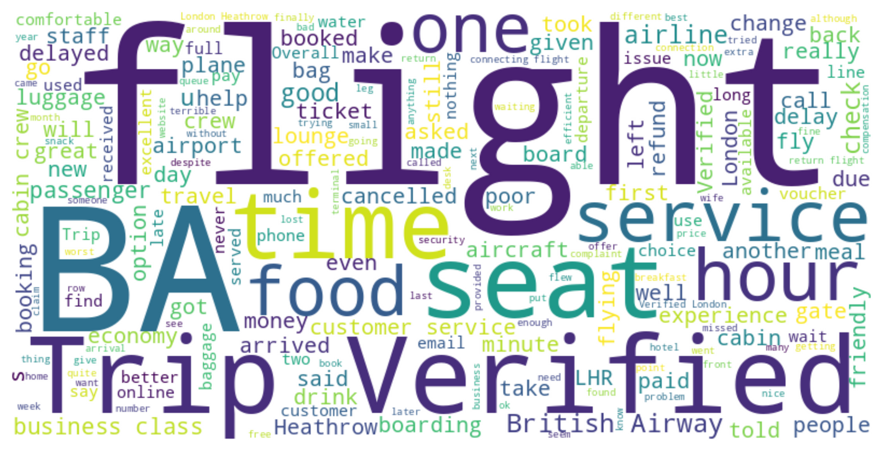
HAFIZ MUHAMMAD SHAHRYAR
THE SENTIMENT ANALYSIS OF 1,000 BRITISH AIRWAYS REVIEWS SHOWS MIXED FEEDBACK, WITH MANY NEGATIVE EXPERIENCES. WHILE SEAT COMFORT AND ENTERTAINMENT WERE PRAISED, KEY COMPLAINTS INCLUDED POOR CUSTOMER SERVICE, BAGGAGE MISHANDLING, DELAYS, AND WEAK COMMUNICATION. PASSENGERS STRUGGLED WITH UNRESPONSIVE SUPPORT AND AUTOMATED RESPONSES.
FOOD QUALITY AND VALUE FOR MONEY WERE ALSO CONCERNS. HEATHROW AIRPORT RECEIVED NEGATIVE REVIEWS FOR EFFICIENCY. BRITISH AIRWAYS SHOULD IMPROVE CUSTOMER SUPPORT, BAGGAGE HANDLING, AND COMMUNICATION TO ENHANCE PASSENGER EXPERIENCE.

